Slide 1
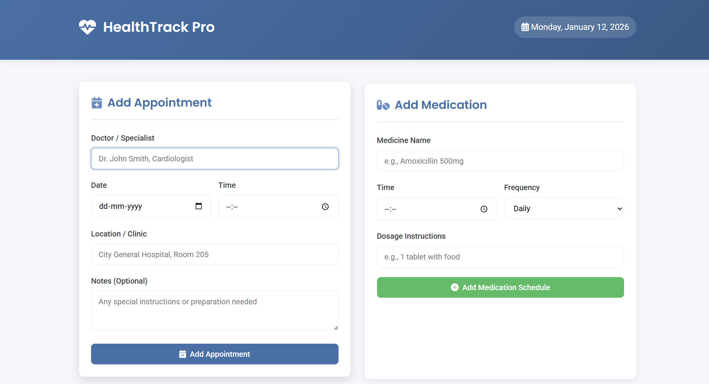
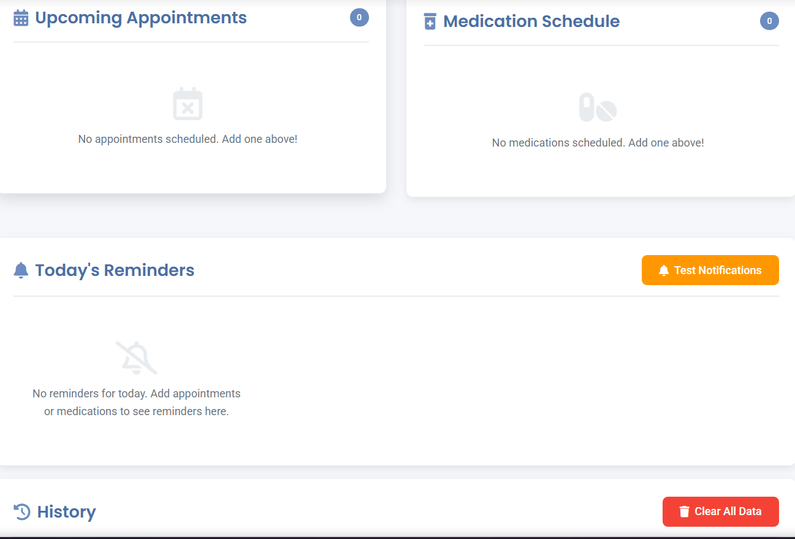
HealthTrack Pro: Revolutionizing Healthcare Management Through Intelligent Tracking
Discover how HealthTrack Pro addresses critical healthcare adherence challenges with an innovative, user-centric approach.

Slide 2

The Challenge: Bridging the Healthcare Adherence Gap
Healthcare today faces significant challenges in patient adherence, leading to suboptimal outcomes and increased costs. Missed appointments, non-compliance with medication regimens, and lack of follow-up are common issues that hinder effective care. These gaps create a complex web of problems for both patients and providers.
Missed Appointments
Medication Non-Adherence
Lack of Follow-Up
Leads to fragmented care and wasted resources.
Results in poor health outcomes and complications.
Prevents timely interventions and preventative care.

Slide 3

Introducing HealthTrack Pro: Your Solution for Intelligent Tracking
HealthTrack Pro is a state-of-the-art platform designed to revolutionize healthcare management. By offering intelligent tracking and intuitive tools, we empower healthcare providers to enhance patient engagement and streamline operations. Our solution focuses on real-time data, predictive analytics, and seamless communication to transform how care is delivered.
Real-time Data
Predictive Analytics
Seamless Communication

Slide 4
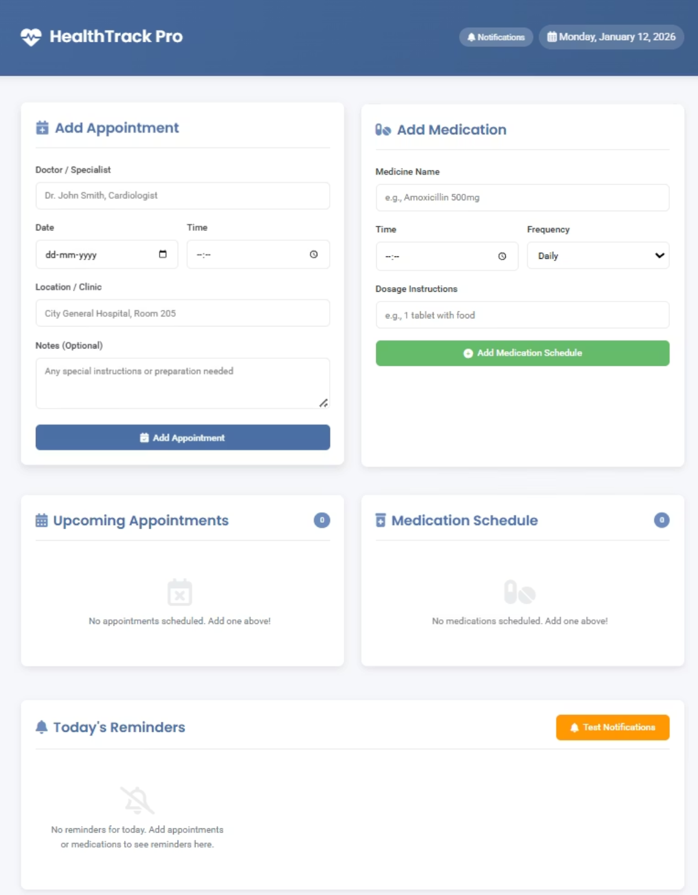
Intuitive Design: A User-Centric Experience
Our software is designed with both patients and healthcare providers in mind. The interface is clean, easy to navigate, and visually consistent with modern design principles. Every element serves a purpose, making complex health information accessible and actionable.
Clear, concise patient dashboards
Actionable insights for clinicians
Simplified data entry and retrieval
Visually consistent and intuitive layouts

Slide 5

Enhancing Patient Adherence: Key Features
Automated Reminders
Personalized Care Plans
Secure Communication
Patients receive timely notifications for appointments and medication.
Tailored plans adapt to individual patient needs and progress.
Direct and private messaging between patients and care teams.
HealthTrack Pro goes beyond simple reminders, offering a comprehensive suite of tools that support patients in managing their health journey. This proactive approach significantly improves adherence rates and fosters a stronger patient-provider relationship.

Slide 6

Streamlining Clinic Workflows: Benefits for Providers
For healthcare administrators and clinic managers, HealthTrack Pro translates into tangible operational efficiencies. Our system reduces administrative burden, minimizes errors, and optimizes resource allocation.
Reduced Administrative Burden
Optimized Resource Allocation
Automate routine tasks and free up staff for patient care.
Better scheduling and patient flow lead to efficient use of staff and facilities.
Improved Data Accuracy
Digital tracking minimizes manual entry errors and ensures reliable data.

Slide 7
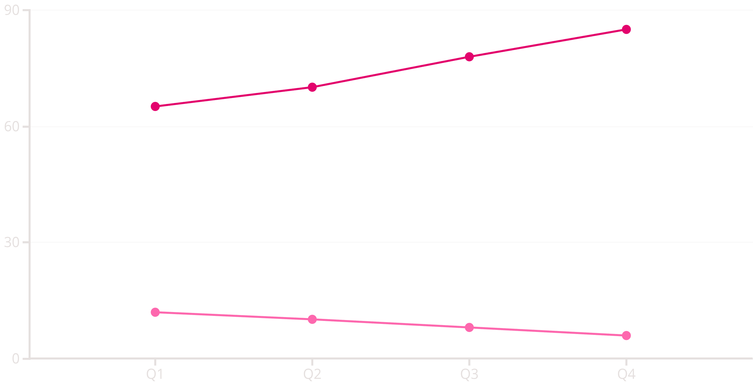
Impact on Outcomes: A Data-Driven Approach
The real measure of HealthTrack Pro's success lies in its ability to drive positive health outcomes. By improving adherence and streamlining care, we see significant improvements in patient health, reduced hospitalizations, and enhanced patient satisfaction.
Adherence Rate (%)
Hospital Readmissions (%)
Our data consistently shows a strong correlation between HealthTrack Pro implementation and improved clinical metrics.

Slide 8




Scalable & Secure: Ready for Your Practice
HealthTrack Pro is built on a robust, scalable architecture that can adapt to practices of all sizes, from small clinics to large hospital systems. Security and privacy are paramount, with all data protected by industry-leading encryption and compliance standards.
Cloud-Based Flexibility
Access your data anytime, anywhere, on any device.
HIPAA Compliance
Ensuring the highest standards of patient data protection.
Enterprise Ready
Scalable solutions tailored to your organization's needs.

Slide 9
Thank You
We appreciate your time and interest in HealthTrack Pro. We are committed to revolutionizing healthcare management and look forward to partnering with you.
Presented by: Tejasvin (24BMH1124), Chinmay(24BMH1114), and Shashank(24BCE5183)

